Slide 1
t-Distributed Stochastic Neighbor Embedding (t-SNE)
Krzysztof Kolasiński Listopad - 2016

Slide 2
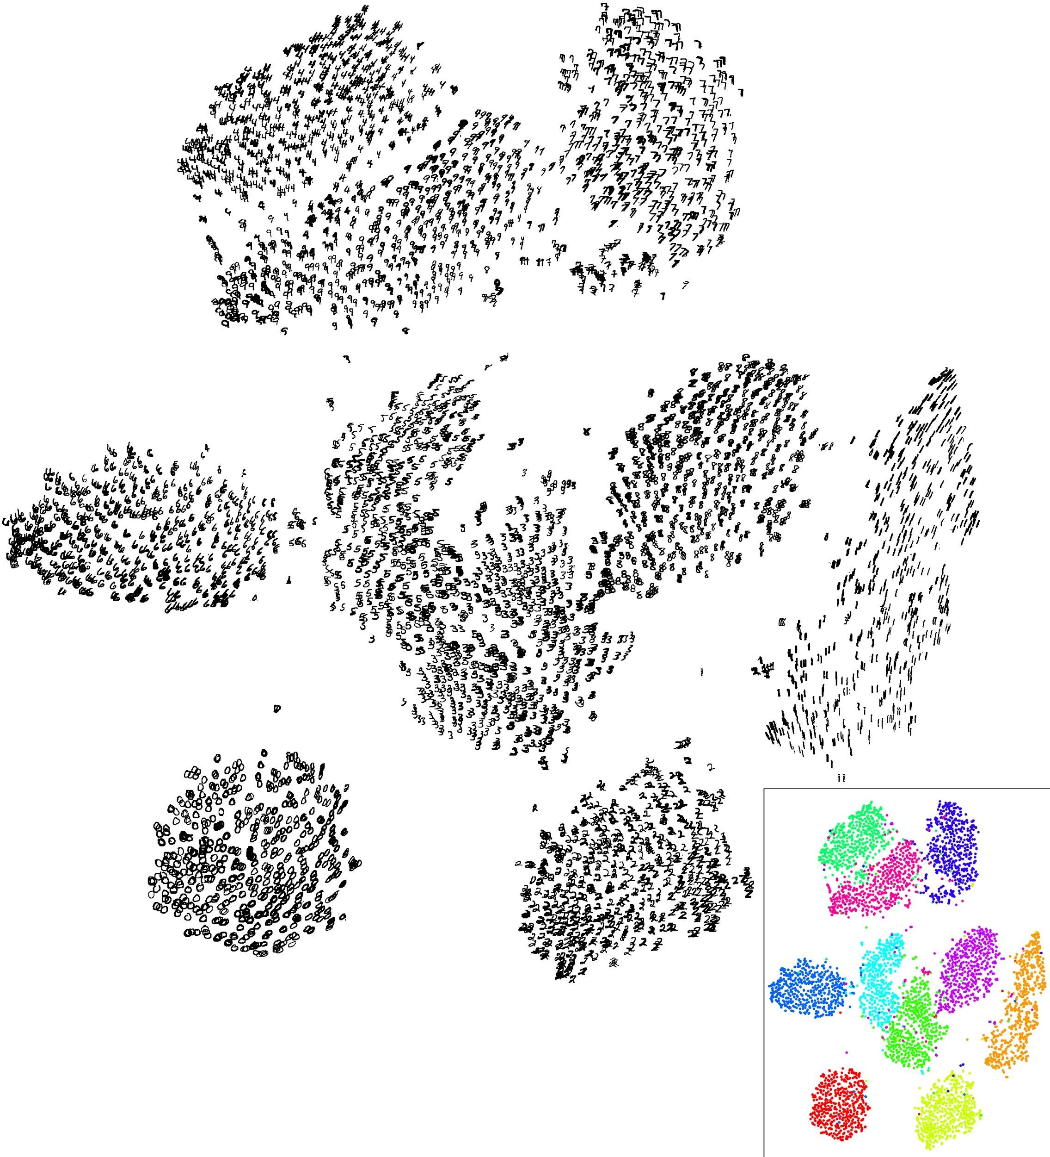
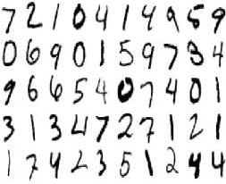
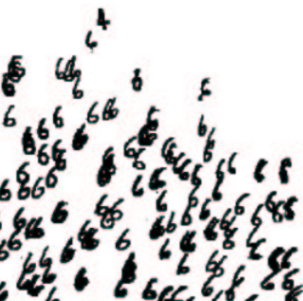
What is t-SNE ?
3D movie result
A technique for dimensionality reduction that is particularly well suited for the visualization of high-dimensional datasets.
t-SNE

Slide 3
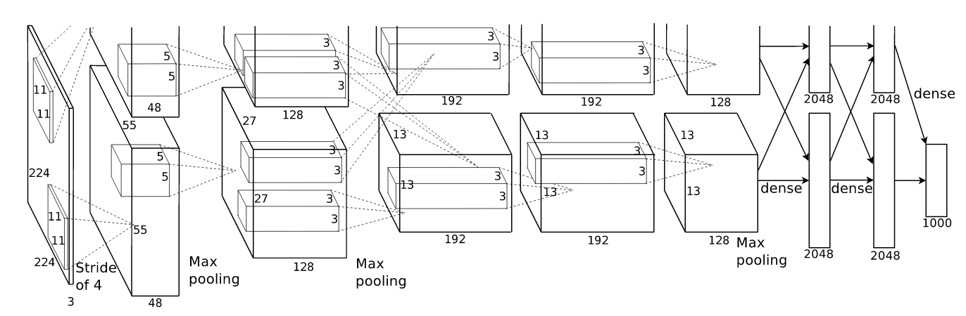

What is t-SNE ?
Another example by A. Karpathy:
AlexNet 2012
4096
50 000 images, 1000 classes
extracted the 4096-dimensional
fc7 CNN

Slide 4
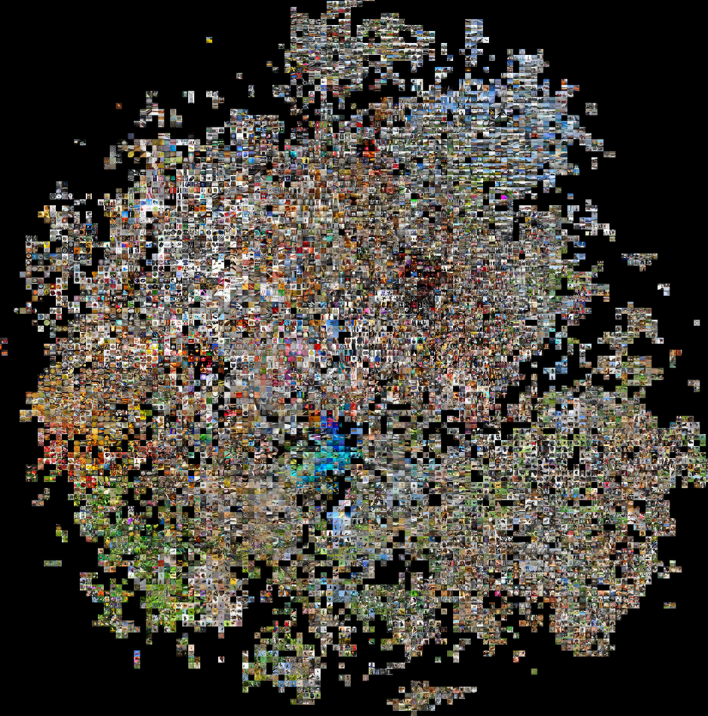
What is t-SNE ?
Another example by A. Karpathy:
AlexNet 2012
t-SNE
4096
extracted the 4096-dimensional
fc7 CNN
Note:
t-SNE, can be used to check if created features or model generalize well and reveal correlation between data.
plot on 2d surface, to each point then an image is assigned

Slide 5
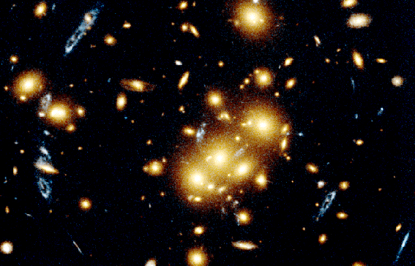
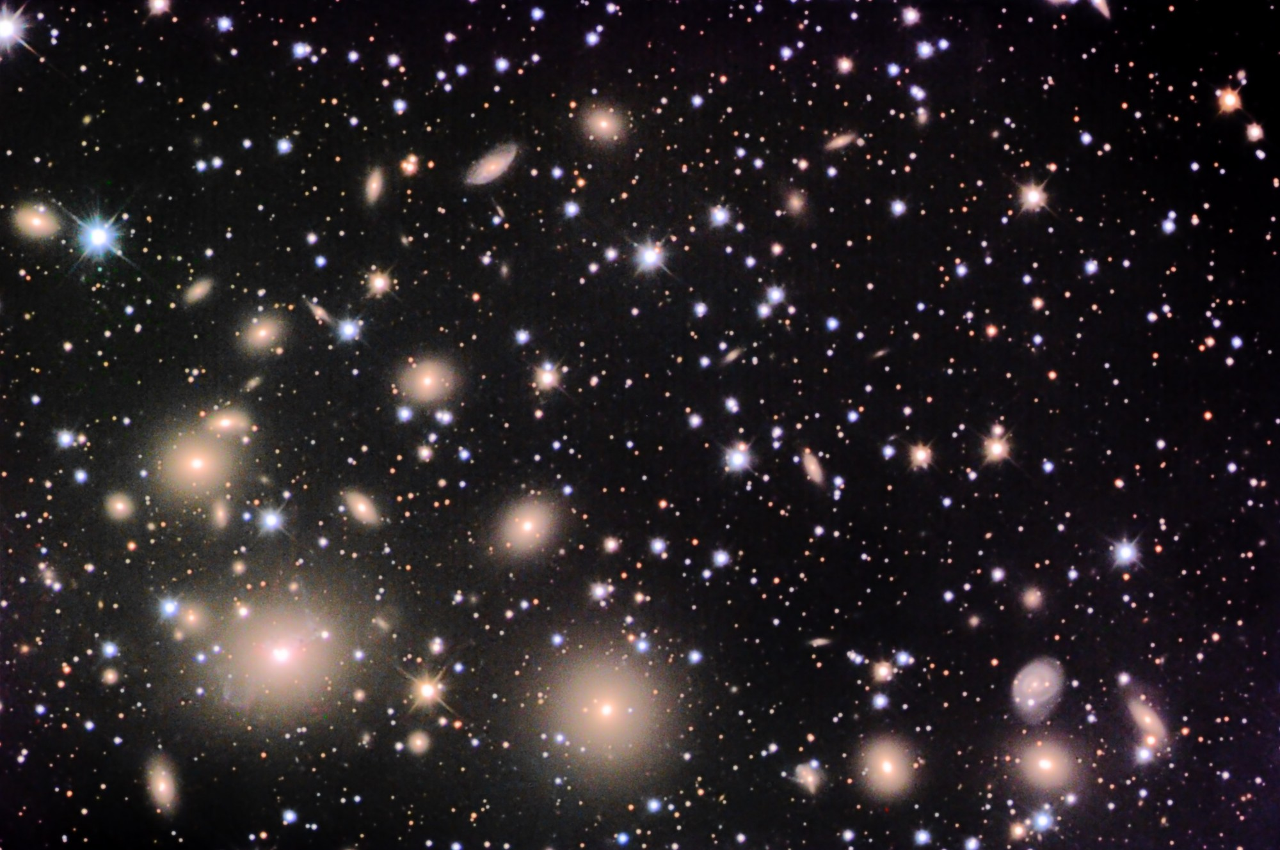
What is t-SNE ?
In my opinion: A n-body problem where the force is defined with special metric
Similar objects are attracted, dissimilar opposite.

Slide 6
A theory behind t-SNE
t-SNE
Student t distribution
(uses t-d)
Stochastic
(uses gradient descent)
Neighbor
(uses distance metric)
Embeding
(embeds results in low
dimensions)

Slide 7
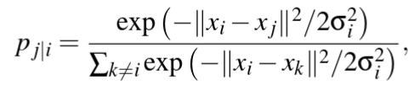
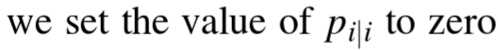
A theory behind t-SNE
the theory will go with simple examples to get intuition (FORTRAN)
We convert high dimensional distances to conditional probabilities of picking j when i has sigma_i:
normalization
explained later

Slide 8
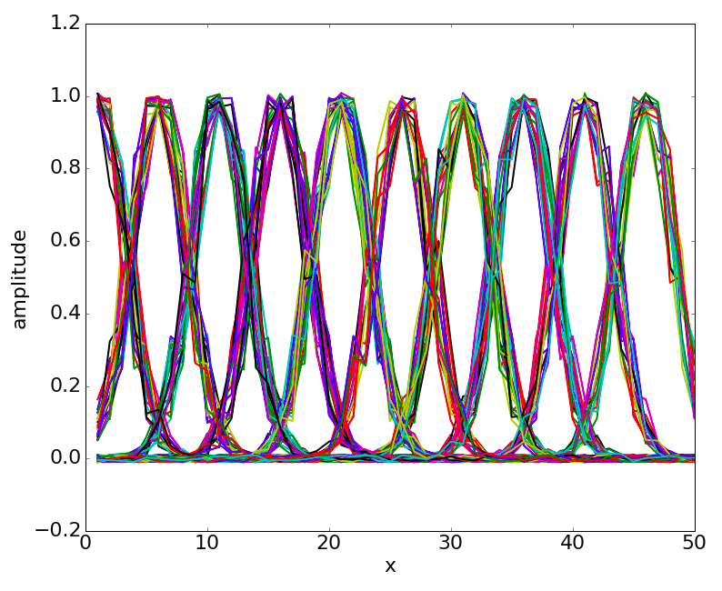
A theory behind t-SNE
the theory will go with simple examples to get intuition (FORTRAN)
We convert high dimensional distances to conditional probabilities of picking j when i has sigma_i:
normalization
Example data generated for testing:
we have 10 classes in 50 dimensional vectors.
what we can see from the pij definition?
we can globally shuffle elements of those vectors and not change pij. Very GOOD!
(in my opinion), we need vector elements to be of the same order, otherwise we may have dominating direction. Probably we need to normalize somehow input for tSNE. Not GOOD!
pij - defined above is not symmetric, which physically is not correct…(can be fixed)

Slide 9
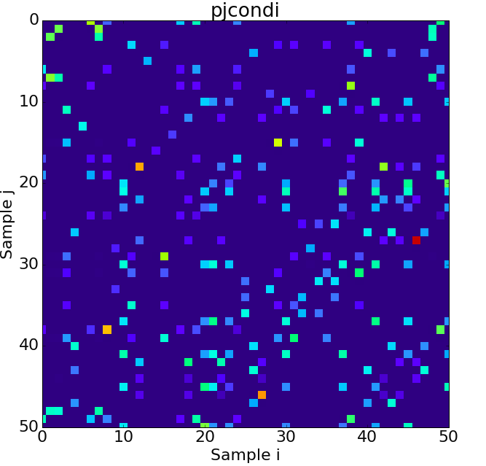
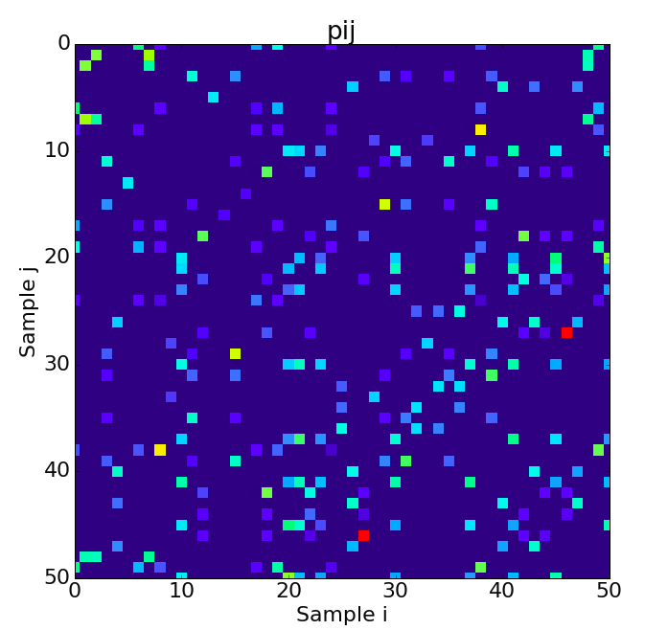
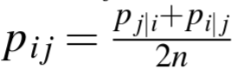
A theory behind t-SNE
We convert high dimensional distances to conditional probabilities of picking j when i has sigma_i:
Lets then symmetrize it and normalize: sum(pij) = 1

Slide 10
A theory behind t-SNE
We convert high dimensional distances to conditional probabilities of picking j when i has sigma_i:
What about sigmas?
The value of sigma_i define neighborhood of surrounding vectors, physically it is an interaction distance.
What t-SNE does?
Define sigma for each vector x such that the perplexity is constant for it, physically we want to have same number of neighbors for each x.
perplexity = złożoność ?

Slide 11
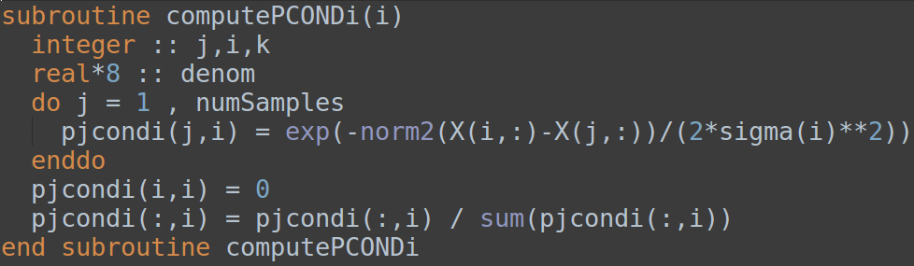
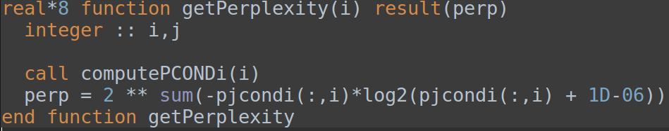
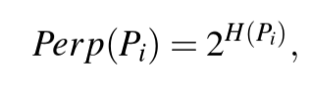
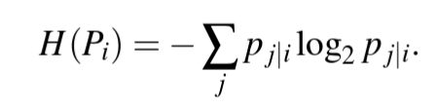
A theory behind t-SNE
We convert high dimensional distances to conditional probabilities of picking j when i has sigma_i:
What is perplexity?
(input parameter for t-SNE)
Shannon entropy

Slide 12
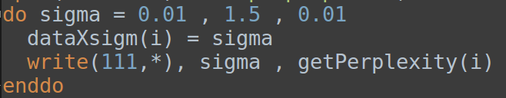
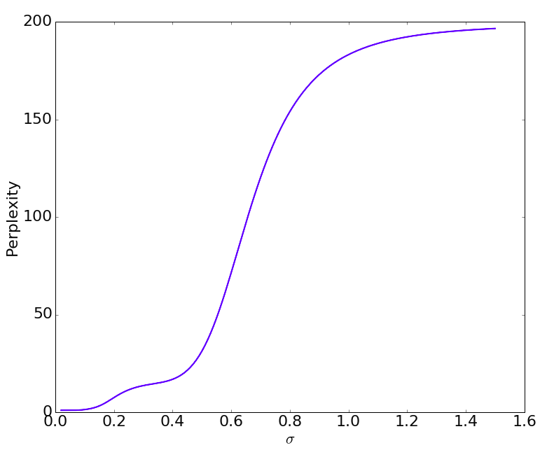
A theory behind t-SNE
We convert high dimensional distances to conditional probabilities of picking j when i has sigma_i:
large sigmas give ~200 i.e. total number of samples
(hint take the limit to see it)
What t-SNE does?
SNE performs binary search for sigma that produces fixed value of perplexity for each X.
Note: This function is monotonic with sigma - binary search is safe
“probably” from here: it starts to interact with others
Perplexity in function of sigma for a selected vector

Slide 13
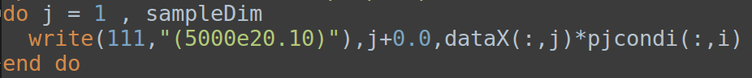
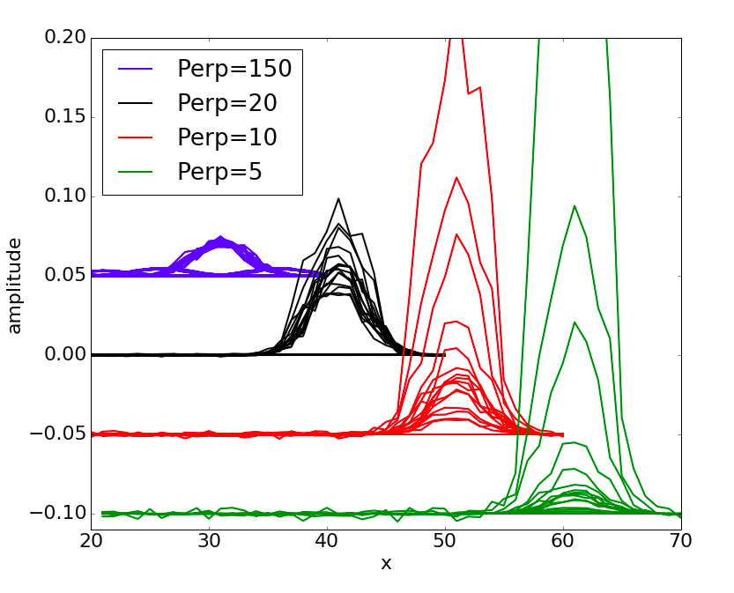
A theory behind t-SNE
We convert high dimensional distances to conditional probabilities of picking j when i has sigma_i:
The effect of the perplexity on neighbor visibility:
x axis is shifted ->
Perplexity in function of sigma for a selected vector
What i-th vector is seeing around? For large sigmas all samples become equally visible.

Slide 14
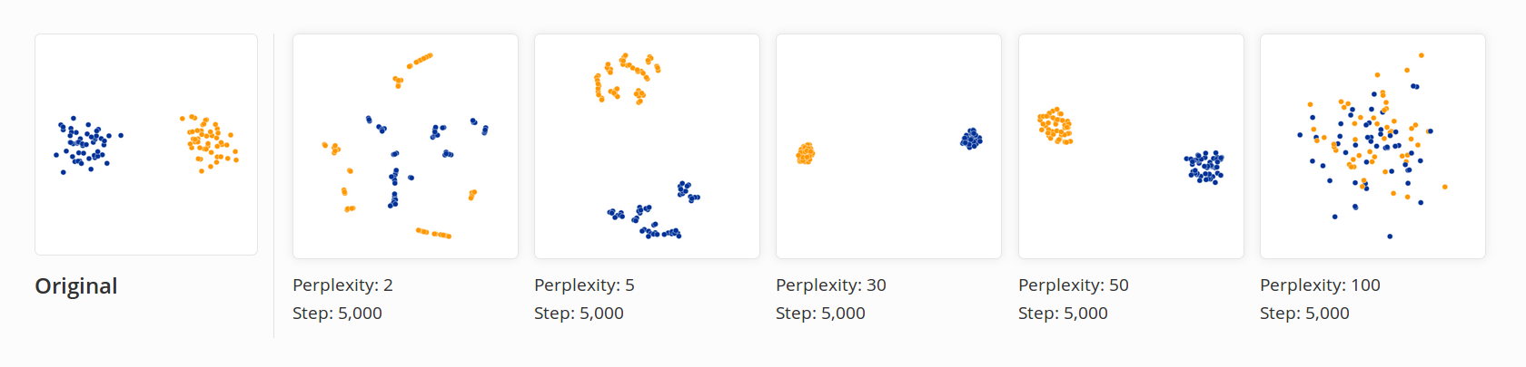
A theory behind t-SNE
We convert high dimensional distances to conditional probabilities of picking j when i has sigma_i:
The value of perplexity really matters:
Nice visualizations: http://distill.pub/2016/misread-tsne/ !!!

Slide 15
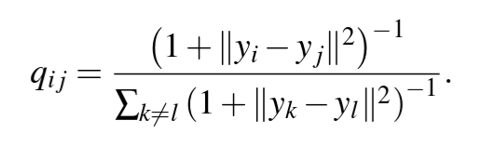
A theory behind t-SNE
We convert high dimensional distances to conditional probabilities of picking j when i has sigma_i:
Calculation of pij probabilities is the first step for t-SNE:
Finally the second step: we introduce another set of variables Y, of the same number of samples what X but is low dimensional. In practice 2 or 3 dimensional vectors e.g. Y = (y₁,y₂) for visualization
Student t-distribution with one degree of freedom: Cauchy distribution
We define joint probabilities as:
TL;TW: this kind of approximation has nice properties, one of them is long tail (for long range interactions),
is similar to Gauss, faster to compute (no exponential). See paper for more details.
NOTE !!!
no sigmas (model simplification, perplexity recomputation for each iteration step would be difficult)
of course we put q_{ii} = 0

Slide 16
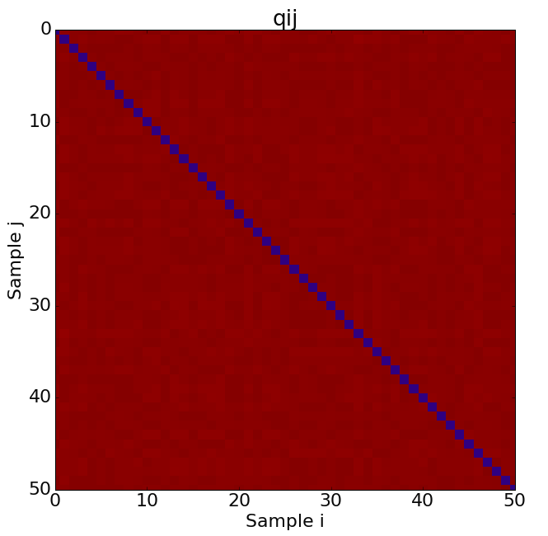
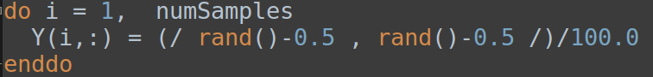
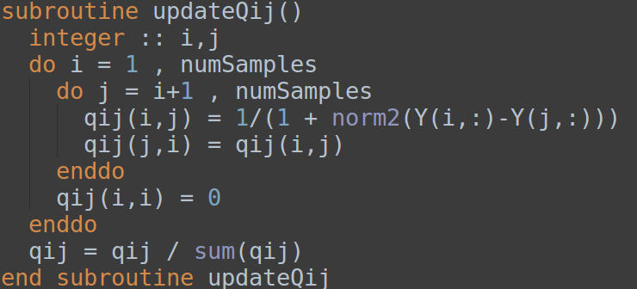
A theory behind t-SNE
Finally the second step: we introduce another set of variables Y, of the same number of samples what X but is low dimensional. In practice 2 or 3 dimensional vectors e.g. Y = (y₁,y₂) for visualization
Student t-distribution with one degree of freedom: Cauchy distribution
We define joint probabilities as:
q_{ij} is initialized with random values:
q_{ii} = 0
note the O(N²) complexity

Slide 17
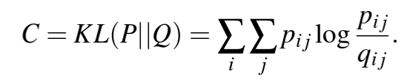
A theory behind t-SNE
Very basic assumption:
We want to have p_{ij} to be equal to q_{ij} i.e. low dimensional vectors Y correctly model similarities between high-dimensional data X.
=
but how to do it?
We can define a measure between two distributions which will tell as how close those distributions are:
Kullback–Leibler divergence
We are going to minimize C with respect to Y vectors
Notes:
C is asymmetric
q_{ij} is force to be large as p_{ij}
but q_{ij} cannot be larger than one, due to normalization, hence stability
p_{ij} are computed once in the first stage of t-SNE

Slide 18
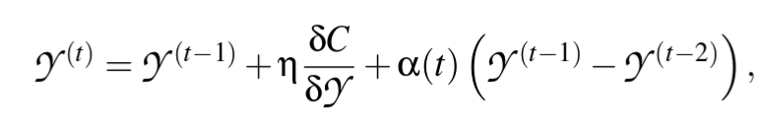
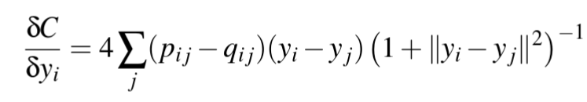
A theory behind t-SNE
Gradient descent:
We want to have p_{ij} to be equal to q_{ij} i.e. low dimensional vectors Y correctly model similarities between high-dimensional data X.
We minimize Kullback–Leibler divergence
learning rate
momentum term
gradient step
gradients derived in original paper

Slide 19
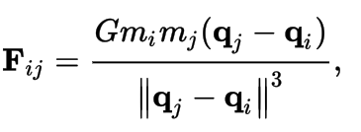
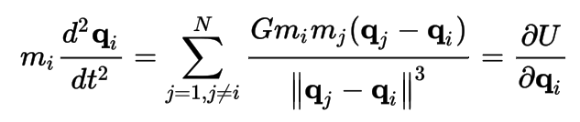
A theory behind t-SNE
PHYSICS BELOW!
Relation to physics
Force from gravity:
Total force which acts on particle i
gradients derived in original paper
mass term: may be positive or negative
force direction
force dumping
From wikipedia: N-body problem
second order
How does it connect to Gradient descent method:

Slide 20
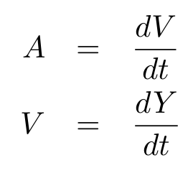
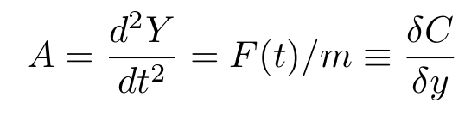
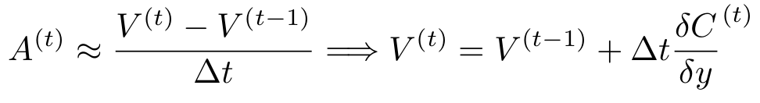
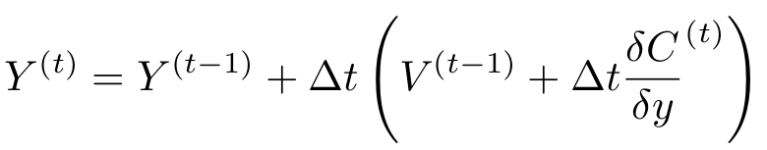
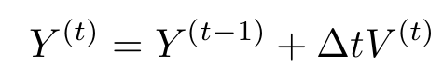
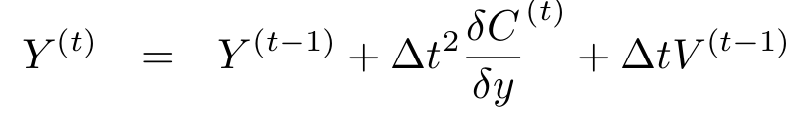
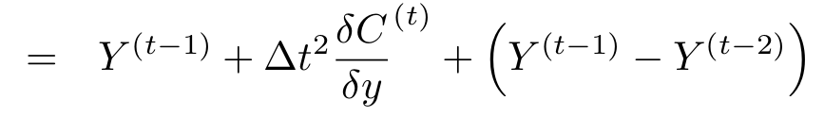
A theory behind t-SNE
Relation to physics
From basic physics we have: acceleration is proportional to Force
Finite difference approximation gives:
Let’s do the same with coordinates Y:
Looks familiar ;)

Slide 21
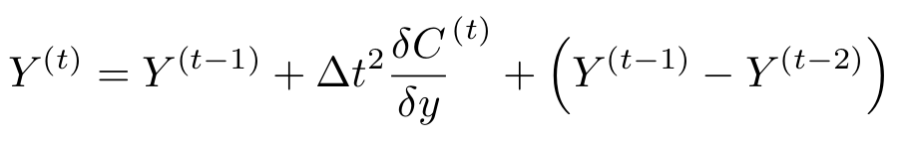
A theory behind t-SNE
Relation to physics
Force
From basic physics we have: acceleration is proportional to Force
without alpha this equation will not give a steady state! We need dumping trick alpha=0.9
t-SNE solves this, only the force is different.

Slide 22
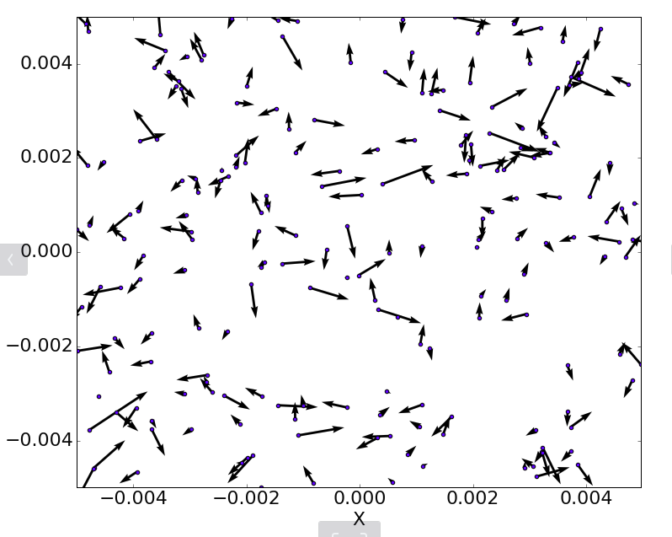
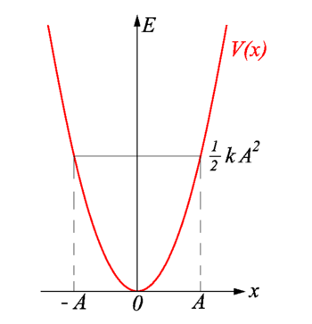
Optimization Methods for t-SNE
We do gradient descent
Adaptive learning rate: Jacobs (1988) (see tSNE paper Sec 3.4)
Dimensionality reduction on X before processing (sklearn has PCA for initial Y vectors)
add L2 norm (“early compression”)
“early exaggeration” - increase interaction between particles by multiplying p_{ij} by some number e.g. 4 in the initial stages of the optimization
derivative of this gives force which keeps particles in the middle increasing mixing between them
mass term is always positive it so force is attractive,
natural clusters arises

Slide 23
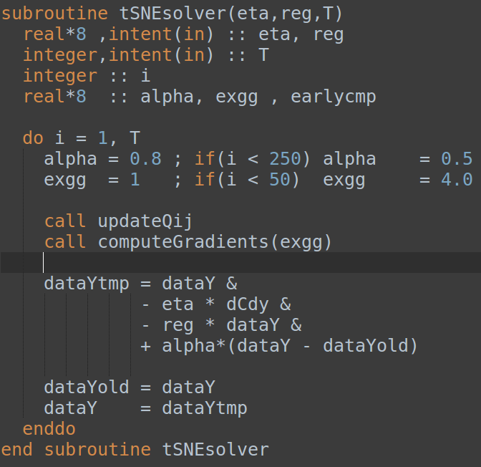
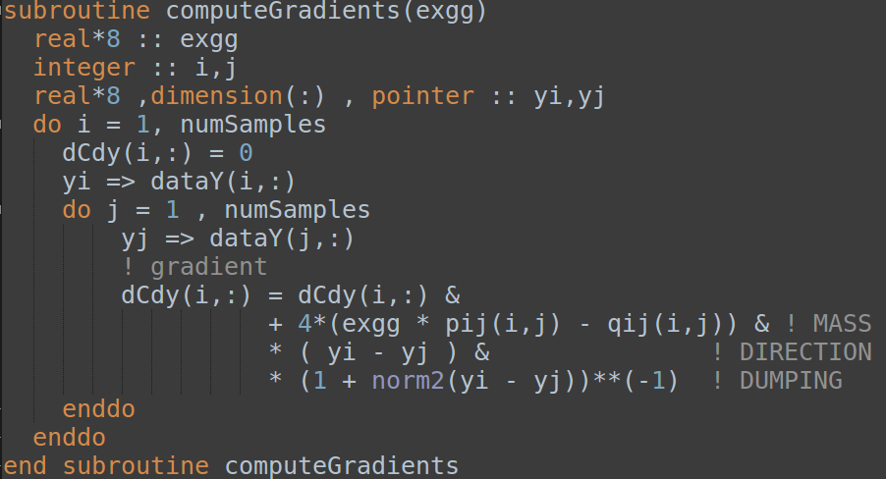
Vanilla implementation in Fortran
minus
Unfortunately:
This has complexity O(N²) :(

Slide 24
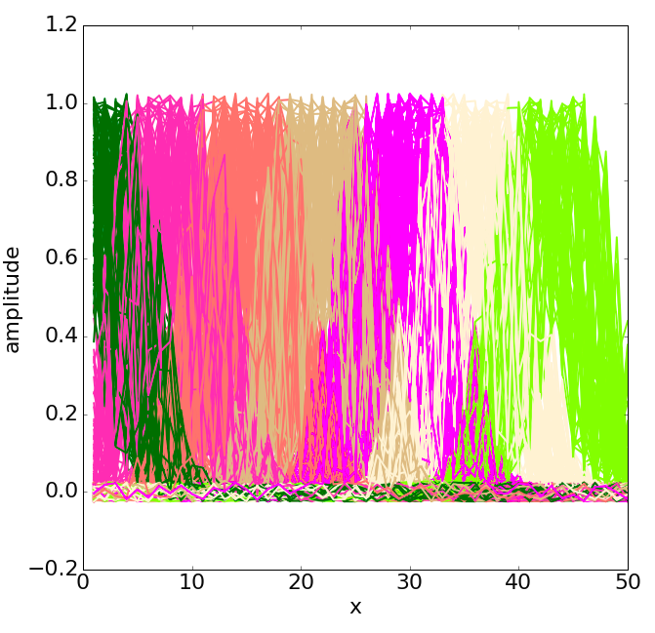
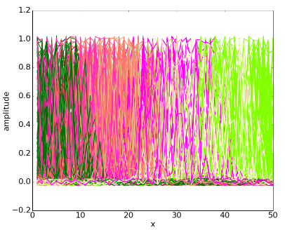
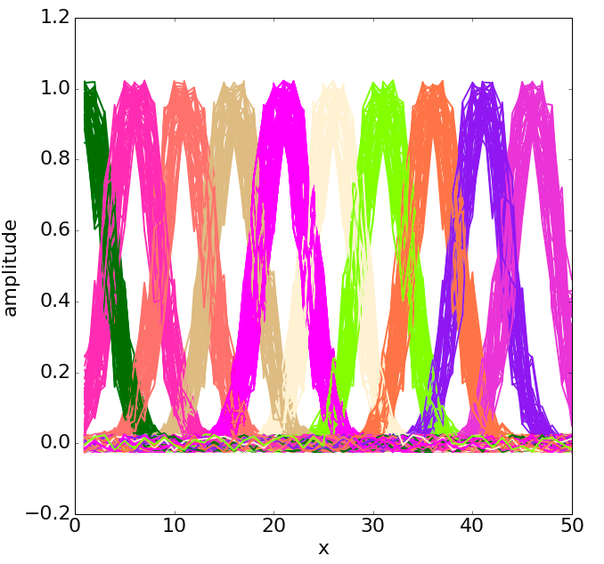
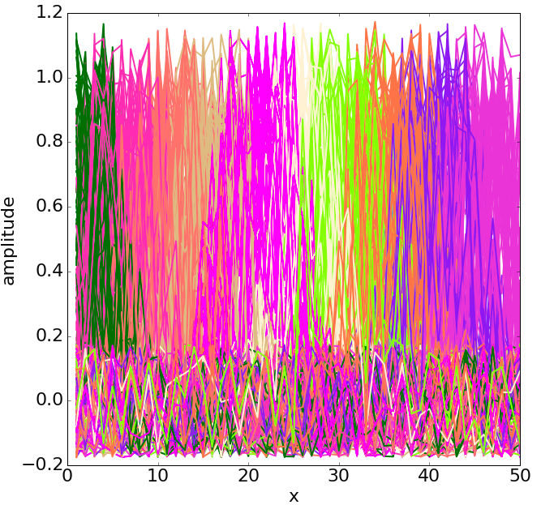
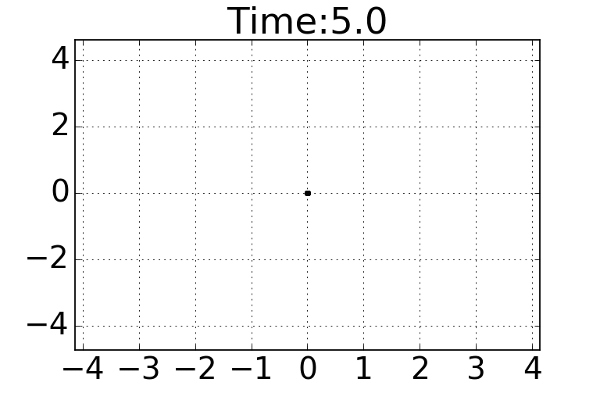
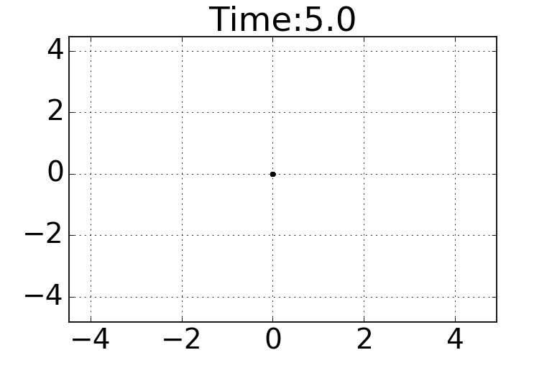
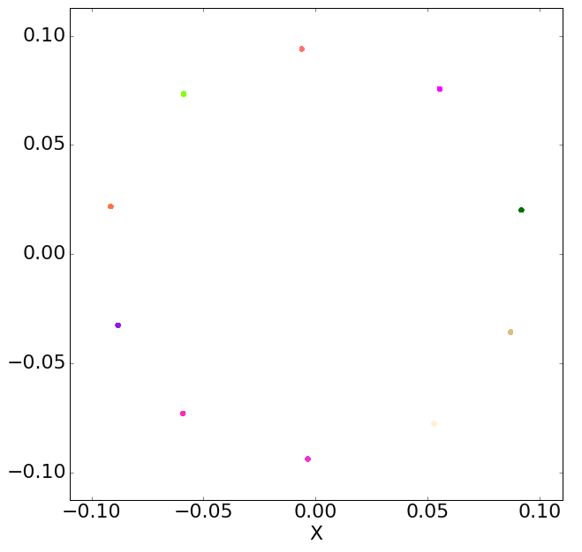


Vanilla examples
Well correlated data:

Slide 25

Other extensions and improvements
L.J.P. van der Maaten and G.E. Hinton. Visualizing High-Dimensional Data Using t-SNE. Journal of Machine Learning Research 9(Nov):2579-2605, 2008. PDF [Supplemental material] [Talk]
So far we have discussed this paper.
‎Cited by 1806
L.J.P. van der Maaten. Learning a Parametric Embedding by Preserving Local Structure. In Proceedings of the Twelfth International Conference on Artificial Intelligence & Statistics (AI-STATS), JMLR W&CP 5:384-391, 2009. PDF
Connect output to neural network with t-SNE and minimize C in order to create dimensionality reduction algorithm.

Slide 26






Other extensions and improvements
L.J.P. van der Maaten and G.E. Hinton. Visualizing Non-Metric Similarities in Multiple Maps. Machine Learning 87(1):33-55, 2012. PDF
zamek
zamek
zamek
???
multimap t-SNE can produce multiple maps which will maximize local structure. Number of maps is a parameter.

Slide 27



Other extensions and improvements
L.J.P. van der Maaten. Accelerating t-SNE using Tree-Based Algorithms. Journal of Machine Learning Research 15(Oct):3221-3245, 2014. PDF
First t-SNE paper in 2008
Barnes–Hut simulation (1986): O(n log n)
Diagonal of cell
center of the mass
wikipedia
sklearn - theta is called angle, LOL
“Angle less than 0.2 has quickly increasing computation time and angle greater 0.8 has quickly increasing error” - sklearn

Slide 28



Other extensions and improvements
L.J.P. van der Maaten. Accelerating t-SNE using Tree-Based Algorithms. Journal of Machine Learning Research 15(Oct):3221-3245, 2014. PDF
https://github.com/DmitryUlyanov/Multicore-TSNE

Slide 29

t-SNE problems
Results hard to interpret (cluster size, cluster distance do not resemble to actual ones)
Non deterministic - results depend on initial conditions
non-parametric mapping - having final solution we cannot embed new points into resulting map (parameteric t-SNE ?)
(in my opinion) lack of state-of-art implementation (multicore on OMP, CUDA without B-H). Quick search gives:

Slide 30

t-SNE problems
sklearn - most general, but slow and unstable (in my case), no parametric, no multimap, a lot of parameters...

Slide 31
References
http://distill.pub/2016/misread-tsne/ nice visualization for intuition with t-SNE
https://lvdmaaten.github.io/publications/papers/JMLR_2008.pdf - orginal papaer
https://github.com/DmitryUlyanov/Multicore-TSNE - multicore OMP implementation of t-SNE
https://lvdmaaten.github.io/tsne/ author’s github page
http://scikit-learn.org/stable/modules/generated/sklearn.manifold.TSNE.html tsne on sklearn

